Slide 1
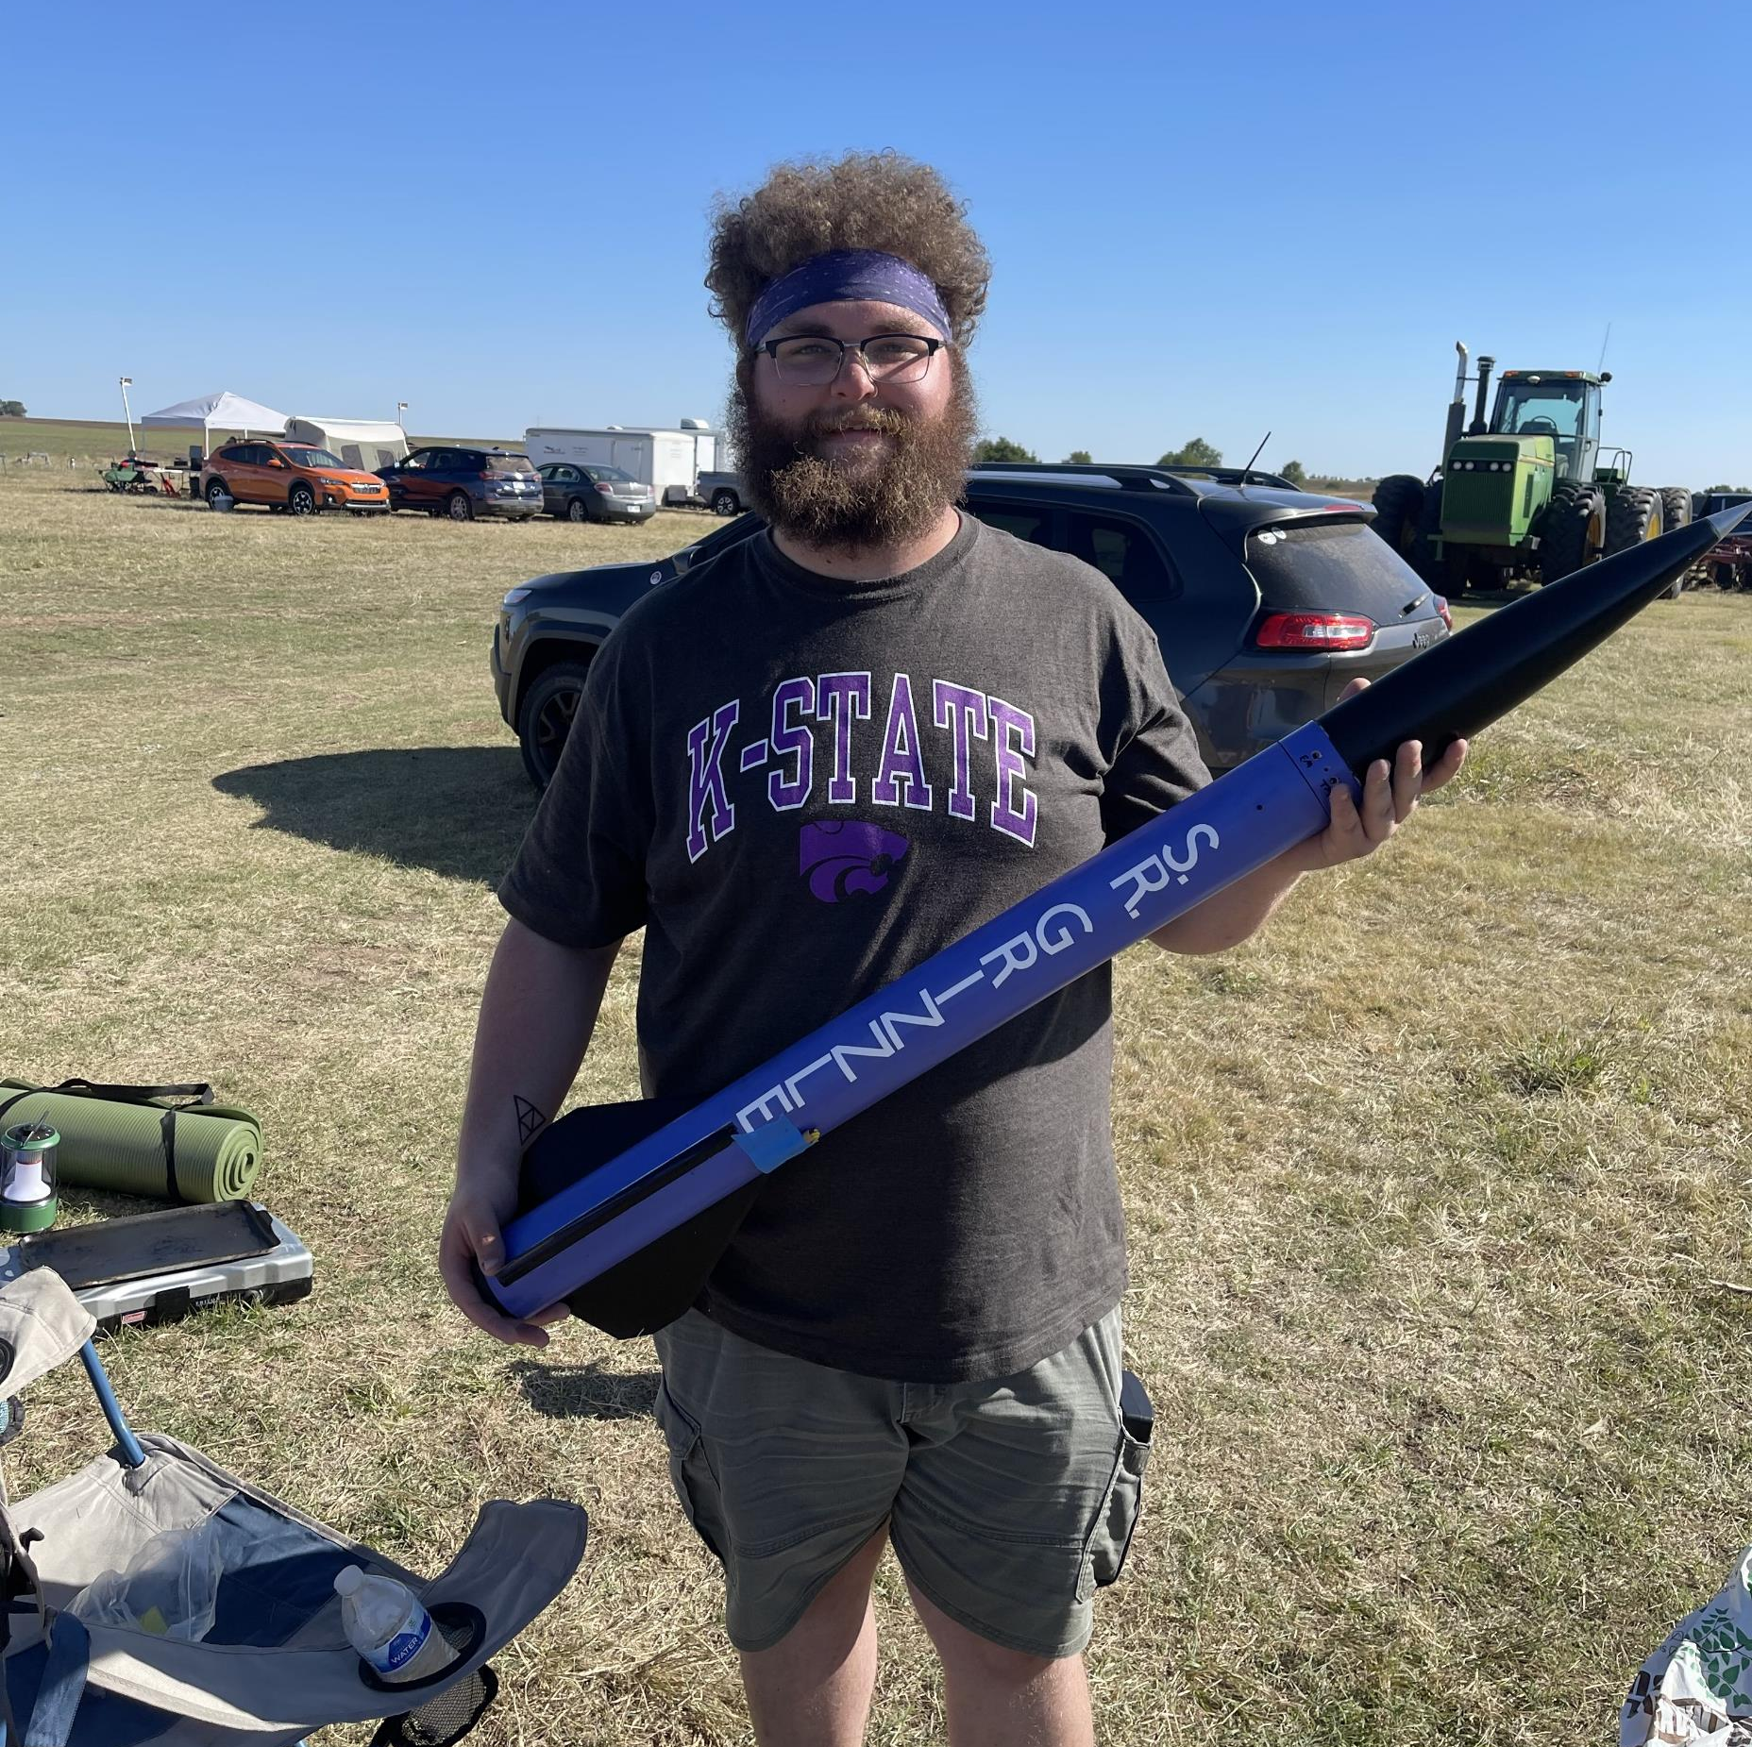
Rocket Flight Computer
Team Apogeenius
Tannyr Singleterry (L)(CMPEN)
Gannon Bird (EE)
Ethan Benne (EE)
Nathan Emerson (CMPEN)

Slide 2
Objectives

Slide 3
Significance and Novelty

Slide 4
Requirements
The ID table thing goes here for requirments

Slide 5
Approach - Microcontroller

Slide 6
Approach - Power Efficiency

Slide 7
Approach - IMU

Slide 8
Approach – PCB Assembly

Slide 9
Approach – UML?

Slide 10
Approach - Webpage

Slide 11
Approach - Standards

Slide 12
Procedure

Slide 13
Testing Board

Slide 14
Verification Plan

Slide 15
Budget

Slide 16
Gantt Chart

Slide 17
Work Breakdown

Slide 18
Feasibility Assessment

Slide 19
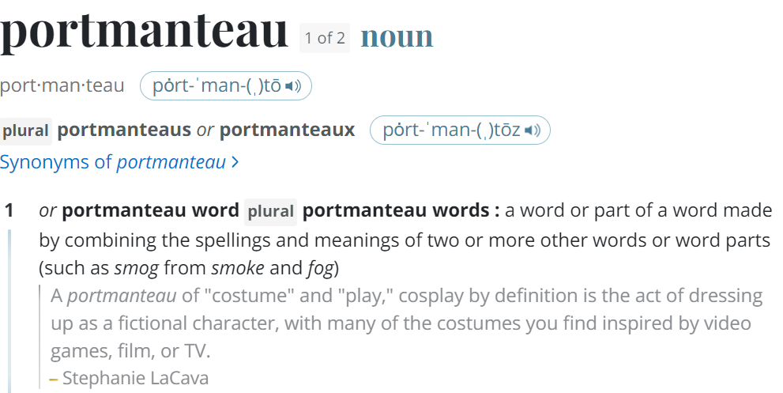
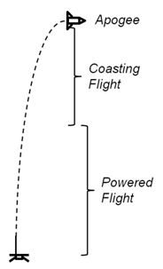
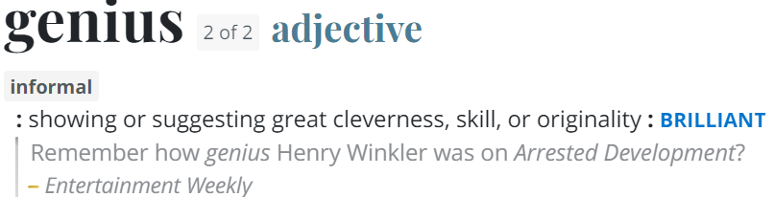
Questions
Image Credit: https://ffden-2.phys.uaf.edu/webproj/211_fall_2014/Adam_Kurzbard/Adam_Kurzbard/Page4.html

